Slide 1

Programming in C Language - Part 1
Veritas University, Abuja, Nigeria

Slide 2
Software Resources for C language
The main software resources required to set up environment for C programming language are Text editor and C compiler.
(a) Text Editor: This will be used to type your program. Eg, notepad, notepad++, OS Edit command, Brief, Epsilon, EMACS and vim or vi.
(b) The C Compiler: The source code written in source file is the human readable source for your program. The compiler compiles the source codes into final executable programs (machine language). GNU C/C++, turbo C, Visual Studio, Codeblocks. Most Compiler tools also include text editors.

Slide 3
Main components of a C program
Preprocessor Commands
Functions
Variables
Constants
Statements & Expressions
Comments

Slide 4
Main C program components explained.
Preprocessor Commands: these are instructions that are executed before actual compilation of the program. They are usually preceded by #. Example; #include <stdio.h>. The commands held within the preprocessor directives are referred to as macros.
Function: is a group of statements that can be called upon multiple times within another computer program.
Standard library functions are predefined c functions that are held in c-program header files and used to aid the operation of the c language.
User-defined functions: are functions that are declared and created by users.

Slide 5
Main C program components cont’d..
Variables: This is the name given to a computer memory location which are used to store values in a computer program.
Constants: refer to fixed values that the program may not alter during its execution. These fixed values are also called literals.
Statements & Expressions: These are computer program instructions.
Comments: This are words and expressions that are not compiled by the computer program. They are usually used to explain the workings of a computer program.

Slide 6
Library and Header Files
Much of the functionality of C is provided by way of functions.
C language is accompanied by a standard library of functions that provide a collection of commonly used operations.
These libraries are a collection of functions and macros that are captured in header files. Therefore, in order to use C language, the user must include header files. Example of a header file; stdio.h

Slide 7
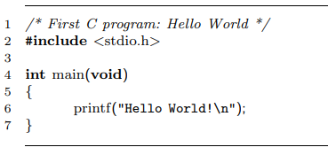
Sample C program

Slide 8
main()
Line 1: is a comment and is not compiled by the C compiler.
Line 2: is a preprocessor directive to include the header file stdio.h. This file contains standard c functions and macros required for the compilation of the code.
Line 3: The c language ignores whitespaces.
Line 4: All C programs have a main() function as the entry point, usually written as. int main(void)
Line 5 and 7: All C functions are enclosed in curly braces. The statements contained within the curly braces are the main statements of the program.
Line 6: The printf(“Hello World!\n”); prints the sentence, Hello World on the output screen.

Slide 9
Variants of the main function
The main function can be expressed in two different forms.
int main(void)
int main(int argc, char *argv[])
The first takes no arguments, and the second receives command-line arguments from the environment in which the program was executed—typically a command-shell.

Slide 10
The preprocessor directive #include <stdio.h> inserts the contents of a file (in this case, a file named stdio.h) into the current file, just as if you had cut and pasted the contents of that file into your source code.
The purpose of these files (known as include files or header files) is to tell the compiler about the existence of external functions which the source code will make use of during the compilation of the program.

Slide 11
The #define preprocessor directive
#define directive is use to define constants in c language.
The #define directive is the simplest form of preprocessor directive in c language. As an example, consider the following program:
#define PI 3.1415926535 void main(void) { printf(“The constant pi is %g\n”, PI); }
As the first step in the compilation process, the preprocessor looks for all occurrences of the token “PI” and replaces it with the token “3.1415926535”. What the actual C compiler sees, then, is the following:
void main(void) { printf(“The constant pi is %g\n”, 3.1415926535); }
Note that the preprocessor has simply substituted the text “3.1415926535” for the text “PI”.

Slide 12
Tokens in C Language
A token in C program is either a keyword, an identifier, a constant, a string literal, or a symbol. For example, the following C statement consists of five tokens:
printf("Hello, Veritas! \n");
The tokens are;
1 - printf 2 - ( 3 - "Hello, Veritas! \n" 4 - ) 5 - ;

Slide 13
Escape Sequence
An Escape Sequence in C is a sequence of characters that doesn’t represent itself when used inside a character or a string literal but has its own specific function.
In C, all escape sequences consist of two or more characters, the first of which is the backslash, \ (called the "Escape character"); the remaining characters determine the interpretation of the escape sequence.
For example, \n is an escape sequence that denotes a newline character.

Slide 14
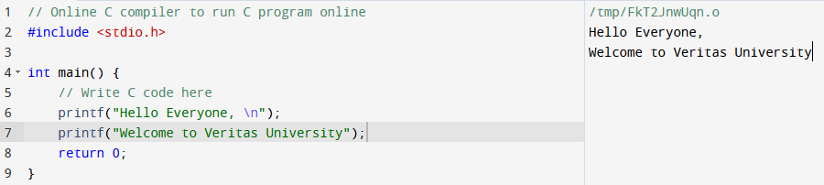
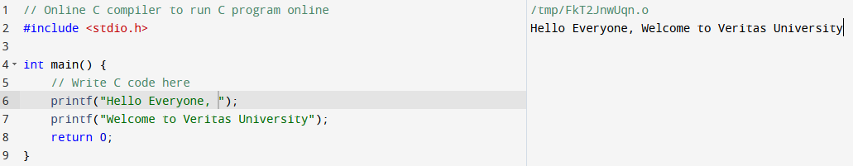
Escape Sequence sample code
Notice that the second code gives all output on the same line because of the removal of \n (newline).

Slide 15
List of Escape Sequence
Escape Sequence | Meaning
\a | Alarm or Beep
\b | Backspace
\f | Form Feed
\n | New Line
\r | Carriage Return
\t | Tab (Horizontal)
\v | Vertical Tab
\\ | Backslash
\' | Single Quote
\" | Double Quote
\? | Question Mark
\nnn | octal number
\xhh | hexadecimal number
\0 | Null

Slide 16
Identifiers
An identifier is a name used to identify a variable, function, or any other user-defined item.
An identifier starts with a letter A to Z, a to z, or an underscore ‘_’ followed by zero or more letters, underscores, and digits (0 to 9).
C does not allow punctuation characters such as @, $, and % within identifiers.
C is a case-sensitive programming language. Thus, Veritas and veritas will be compiled as two different identifiers.
Example of identifiers: _veritas one_a myDice abc x

Slide 17
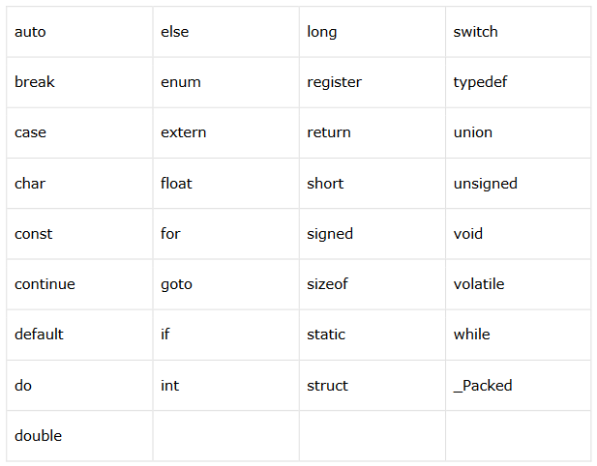
C language Keywords
Keywords are reserved words that may not be used as constants, variables or identifiers in C language

Slide 18
Data types in C language
There are four fundamental data types in C
Basic
Derived
Void
Enumeration

Slide 19
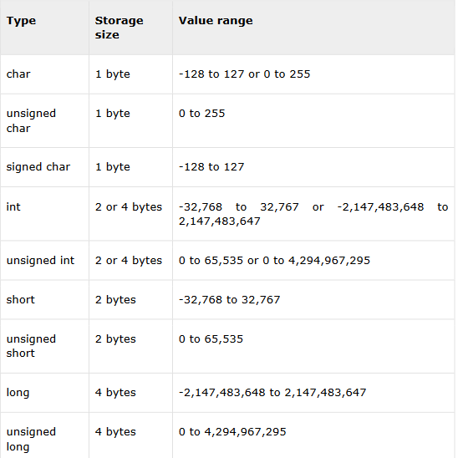
1. Basic types in C
Data types under the basic category include,
char - characters,
int – integer:
float - floating-point numbers.
double – double
integer values can be signed (-ve) or unsigned values (+ve). Int values are always signed unless specifically mentioned.

Slide 20
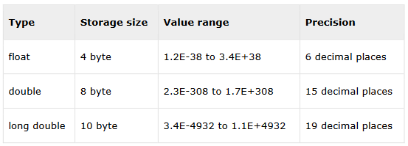
Floating point type

Slide 21
Derived, void and Enumerated
The void data type indicates that no value is available.
Derived data types: Derived data types include array, structure, union and pointer.
Enumerated types are a special way of creating your own Type in C.

Slide 22
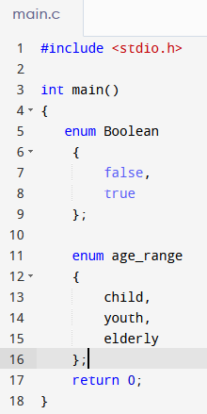
Enumerated data types
The key word for an enumerated type is enum. For example, we could create an enumerated type for true and false (note: this is done for you by C and is type bool).

Slide 23
Type qualifier
Type qualifier are C-language keywords that are used to affect the size of data types.
The keywords short and long are type qualifiers because they affect the size of a basic int type.
The qualifier long may also be applied to type double.
Note, short and long, when used on their own as in
short a;
long x;
are equivalent to writing short int and long int, respectively.
Other type qualifiers2 are signed, unsigned, const, and volatile.

Slide 24
Format Specifiers
Format specifiers are used to specify the data type of variables during input and output operations.
Some commonly used format specifiers.
int - %d
char – %c
float - %f
double - %lf

Slide 25
Format Specifiers
 | Format Specifier | Type
1 | %c | Character
2 | %d | Signed integer
3 | %e or %E | Scientific notation of floats
4 | %f | Float values
5 | %g or %G | Similar as %e or %E
6 | %hi | Signed integer (short)
7 | %hu | Unsigned Integer (short)
8 | %i | Unsigned integer
9 | %l or %ld or %li | Long

Slide 26
Format specifiers
10 | %lf | Double
11 | %Lf | Long double
12 | %lu | Unsigned int or unsigned long
13 | %lli or %lld | Long long
14 | %llu | Unsigned long long
15 | %o | Octal representation
16 | %p | Pointer
17 | %s | String
18 | %u | Unsigned int
19 | %x or %X | Hexadecimal representation
20 | %n | Prints nothing
21 | %% | Prints % character

Slide 27
Constants
Constants can have different types and representations.
First, an integer constant 1234 is of type int.
A constant of type long int is suffixed by an L, 1234L; (integer constants too big for int are implicitly taken as long). An unsigned int is suffixed by a U, 1234U, and UL specifies unsigned long.
Integer constants may also be specified by octal (base 8) or hexadecimal (base 16) values, rather than decimal (base 10). Octal numbers are preceded by a 0 and hex by 0x.
Thus, the value 1234 can be presented as,
1234 (decimal)
02322 (octal / base 8)
0x4D2 (Hexadecimal/ base 16)
Note: C language does not provide a direct binary representation. However, the hex form is very useful in practice as it breaks down binary into blocks of four bits.

Slide 28
Constants cont’d…
Character constants, are specified with single quotes
Example ’a’, ’\n’, ’7’.
Note: Character constants are in fact, not of type char, but of int. This is because most platforms represent characters using the ASCII character set, which associates the integers 0 to 127 with specific characters (e.g., the character ’T’ is represented by the integer 84).
Thus, sizeof(’Z’) will equal 4 on a 32-bit machine, not one.
You can find a comprehensive tables of the ASCII character set online.

Slide 29
Constants cont’d…
String constants, such as "This is a string" are delimited by double quotes (note, the quotes are not actually part of the string constant). They are implicitly appended with a terminating ’\0’ character.
Thus, in memory, the above string constant would comprise the following character sequence: This is a string\0
It is important to differentiate between a character constant (e.g., ’Y’) and a NUL terminated string constant (e.g., “Y"). The latter is the concatenation of two characters X and \0.

Slide 30
Symbolic constants
Symbolic constants represent constant values, from the set of constant types mentioned above, by a symbolic name.
For example,
#define CLASS_SIZE 100
#define HOSTEL_POP (16*CLASS_SIZE)
#define HELLO “Welcome to Veritas\n"
#define EXP 2.7183
Wherever a symbolic constant appears in the code, it is equivalent to direct text-replacement with the constant it defines.
For example, printf(HELLO); will print Welcome to Veritas. (see next slide).

Slide 31
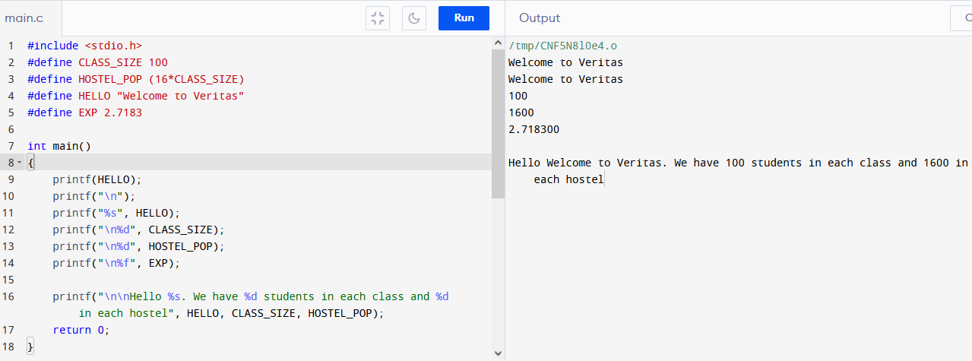
Sample code on using #define
Note the use of the format specifiers, %s (string), %d (integer) and %f (floating point).
Notice that the escape sequence \n: is used for new line.

Slide 32
Other # directives
Other # directives that are worth researching include, #ifdef, #else, #else, #endif, #undef, #define, #if, #ifdef, #error, #elif, #pragma

Slide 33
Basic Arithmetic Operators
Operator | Symbol
Addition | +
Subtraction | -
Multiplication | *
Division | /
Modulus | %

Slide 34
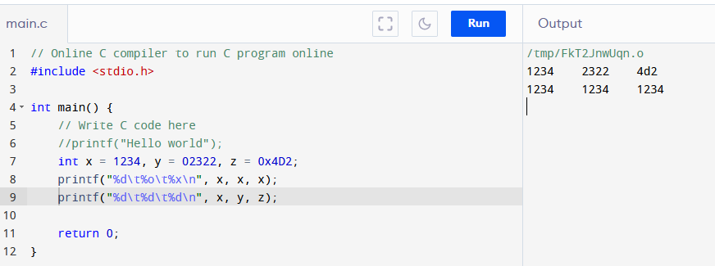
Sample codes

Slide 35
Class task
Write a simple C language program that gives the output shown below, using;
the printf() function
\n and \t escape characters
*****************************************************************************************
* VERITAS UNIVERSITY *
* DEPARTMENT OF COMPUTER SCIENCE *
*****************************************************************************************
* MY NAME IS (YOUR FULL NAME) *
* I AM IN 300 LEVEL *
* I CREATED THIS WITH C PROGRAMMING LANGUAGE *
*****************************************************************************************

Slide 36
*****************************************************************************************
* VERITAS UNIVERSITY *
* DEPARTMENT OF COMPUTER SCIENCE *
*****************************************************************************************
* MY NAME IS (YOUR FULL NAME) *
* I AM IN 300 LEVEL *
* I CREATED THIS WITH C PROGRAMMING LANGUAGE *
*****************************************************************************************

